Slide 1
STOCK PRICE PREDICTION USING GAN
Done by: M . Prabhakaran
Reg.No.:912321104031
Branch: III YEAR CSE
College Name: SACS MAVMM ENGINEERING COLLEGE
Email ID:pm3177656@gmail.com
Nanmudhalvan ID: au912321104031

Slide 2
Project Outline:
Problem Statement
Proposed System / Solution
System Development Approach
Algorithm and Deployment
Result
Conclusion
References

Slide 3
Problem Statement:
The aim of this project is to develop a framework for predicting stock prices with high accuracy and reliability. Traditional time-series forecasting methods often struggle to capture the complex and non-linear dynamics inherent in financial markets. Therefore, the objective is to leverage the power to generate realistic and meaningful stock price predictions, taking into account the inherent uncertainties and complexities of the financial domain.

Slide 4
PROPOSED SYSTEM / SOLUTION
STEPS
Data Generation
Discriminator Network
Generator Network
Prediction
Evaluation
Robustness and Generalization

Slide 5
Proposed System / Solution(contd…)
1. Data Generation:
One approach is to train a GAN to generate synthetic stock price data that resembles the real stock price data.
2. Discriminator Network:
The discriminator network in the GAN is trained to distinguish between real and synthetic stock price data.
3. Generator Network:
The generator network in the GAN learns to generate synthetic stock price data that is indistinguishable from real stock price data.

Slide 6
Proposed System / Solution(contd…)
4. Prediction:
Once the GAN is trained, you can use the generator network to generate future stock price data points.
5. Evaluation:
The generated stock price predictions need to be evaluated using standard evaluation metrics to assess their accuracy and reliability.
6. Robustness and Generalization:
Assess the robustness of the GAN-based model to variations in input data and external factors.

Slide 7
System Development Approach
a. HARDWARE REQUIREMENTS:
GPU (Graphics Processing Unit):
GANs, like many deep learning algorithms, benefit greatly from GPU acceleration. GPUs are optimized for parallel processing, which is crucial for training complex models efficiently.
Storage:
SSDs (Solid State Drives) are preferred over HDDs (Hard Disk Drives) for faster data access, which can help speed up training and inference.
Python library tools:
Ensure that you have the necessary deep learning frameworks installed, such as TensorFlow or PyTorch, along with any other libraries required for preprocessing, visualization, and evaluation.

Slide 8
System Development Approach(contd…)
b. SOFTWARE REQUIREMENTS:
Python:
Python is the primary language for most deep learning tasks, including GAN implementation.
Data Visualization:
Data visualization libraries like Matplotlib or Seaborn are essential for visualizing stock price data, model outputs, and evaluation metrics.
Version Control:
Use version control software such as Git to manage your project's codebase, track changes, and collaborate with team members if applicable.

Slide 9
Algorithm & Deployment
ALGORITHM:
Data Preparation:
training and testingPreprocess the data by handling missing values, normalizing the features, and splitting it into sets.
Generator Network:
Train the generator network to learn the mapping from the input noise vector to realistic stock price data.

Slide 10
Algorithm & Deployment(contd…)
Discriminator Network:
Train the discriminator network to distinguish between real and synthetic stock price data.
Training Process:
Alternately train the generator and discriminator networks in a min-max game setup.

Slide 11
Algorithm & Deployment(contd…)
DEPLOYMENT:
Model Optimization:
Optimize the trained GAN model for deployment by reducing its size and computational complexity.
Integration with Deployment Environment:
Integrate the GAN model into the target deployment environment, whether it’s a web application, mobile app, or server-based system.

Slide 12
Algorithm & Deployment(contd…)
API Development (Optional):
Develop an API (Application Programming Interface) for accessing the GAN model predictions programmatically.
2. Model Hosting:
Choose a suitable hosting solution for deploying the GAN model, such as cloud-based platforms like Amazon Web Services (AWS), Google Cloud Platform (GCP), or Microsoft Azure.

Slide 13
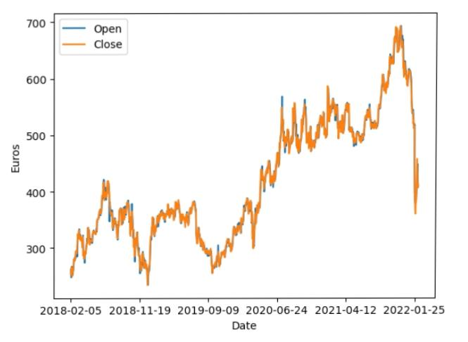
Result:
Fig.open And Close For Stack Price Prediction

Slide 14
Reference:
https://seaborn.pydata.org/
https://matplotlib.org/
https://pandas.pydata.org/
https://www.kaggle.com/
https://www.kaggle.com/code/kevinli3434/netflix-price-prediction

Slide 15
Conclusion:
Predicting stock prices using Generative Adversarial Networks (GANs) is a complex and challenging task. While GANs have shown promise in generating realistic data, their effectiveness in accurately predicting stock prices remains uncertain.

Slide 16
THANK YOU

